Slide 1
STAT 131
RANDOM VARIABLES &
DISCRETE PROBABILITY DISTRBUTIONS

Slide 2
To be a probability distribution or a discrete distribution
all P(X=x) > 0 and all P(X=x) < =1
and ΣP(X=x)=1
OR in the alternative notation
all p_{x} > 0 and all p_{x} < 1
and Σp_{x} =1

Slide 3
Defining a probability distribution
Two methods of defining
Charts showing x and P(X=x)
Tables showing x and P(X=x)

Slide 4
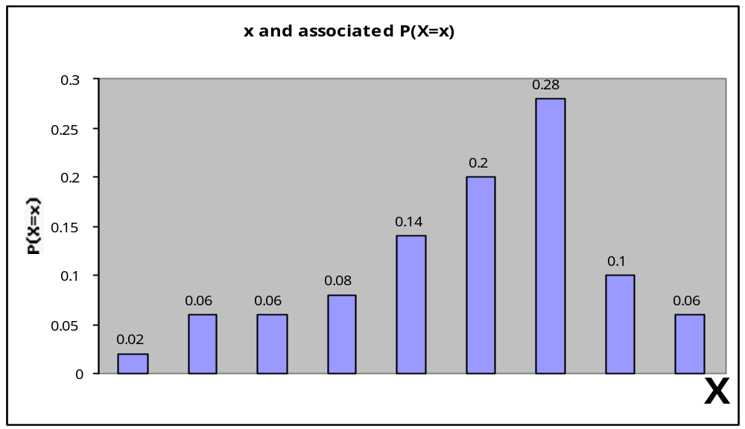
Defining a probability distribution: bar charts
3 4 5 6 7 8 9 10 11

Slide 5
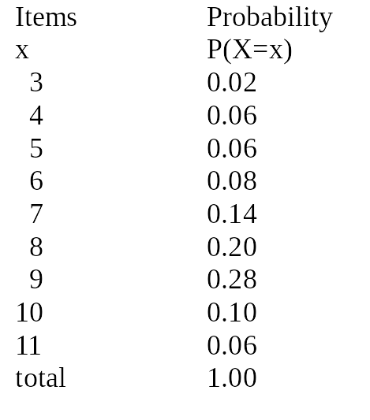
Defining a probability distribution: tables of x and P(X=x)

Slide 6
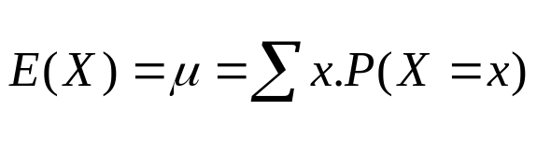
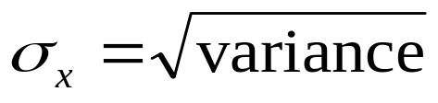
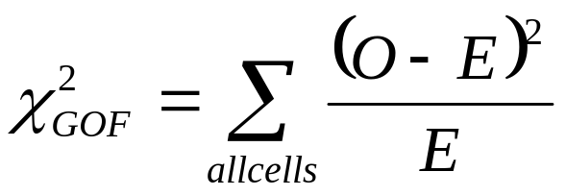
Features of interest for
Discrete Random Variables
P(X=x)=? (May involve reading table or calculations)
Centre
  Mean
Spread
  Variance
  Standard Deviation
Do the data fit a given model?

Slide 7
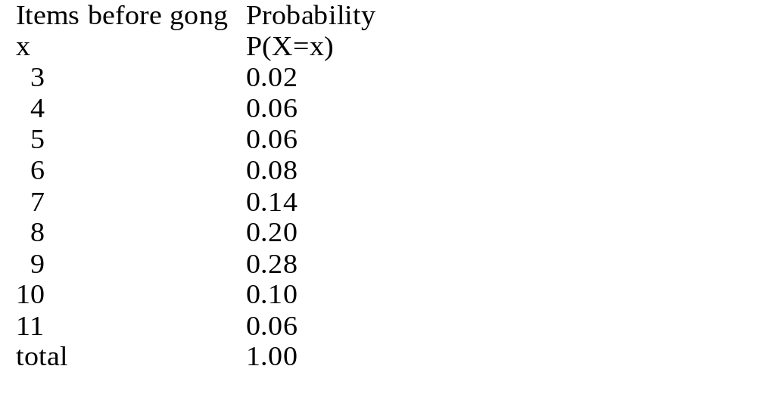
Answering probability questions
What is the probability
that the gong will occur
after the 8th item is read?
0.20
What is the probability
That the gong will occur
after 8 or more items
are read?
0.64

Slide 8
Answering questions
What is the probability that
the number of items will be
less than 8 before the gong?

Slide 9
Answering questions
What is the probability that
the number of items will be
less than 8 before the gong?
1- 0.64=0.36
Or
0.02+0.06+0.06+0.08+0.14=0.36

Slide 10
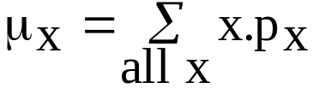
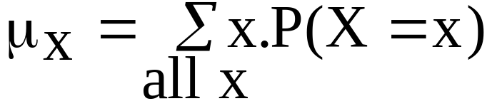
Centre: E(X) or mean of model μ
or
x.P(X=x)

Slide 11
Centre: E(X) or mean of a RV or model, μ
or
x.P(X=x)
x.P(X=x)
3x0.02
4x0.06
5x0.06
6x0.08
7x0.14
8x0.20
9x0.28
10x0.10
11x0.06
0.06
0.24
0.30
0.48
0.98
1.60
2.52
1.00
0.66
7.84

Slide 12
Mean (Expected value) of the Random Variable X (of Model)
E(X) or μ_{x}=7.84 is mean number of items read before the gong

Slide 13
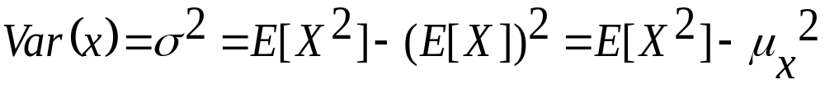
Variance: of the Discrete Random Variable X

Slide 14
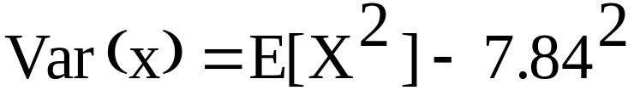
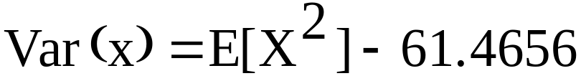
Variance: Using the definition
We calculated E(X) = 7.84

Slide 15
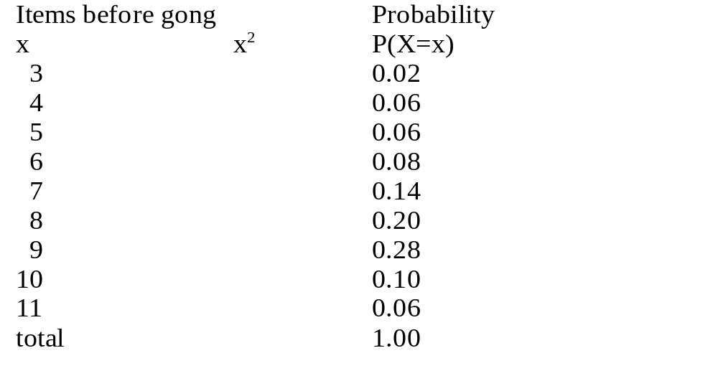
Spread:variance of a model, σ²
Find E[X²]
=Σ x².P(X=x)
x².P(X=x)

Slide 16
Spread:variance of a model, σ²
Find E[X²]
=Σ x².P(X=x)
x².P(X=x)
9
16
25
36
49
64
81
100
121
0.18
0.96
1.50
2.88
6.86
12.80
22.68
10.00
7.26
65.12

Slide 17
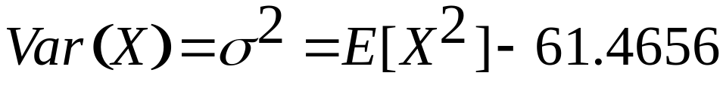
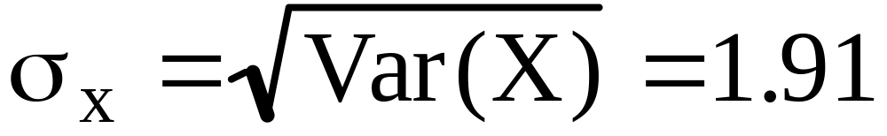
Spread: variance, σ² of model
Hence Var(X)=3.6544
and the standard deviation is ?

Slide 18
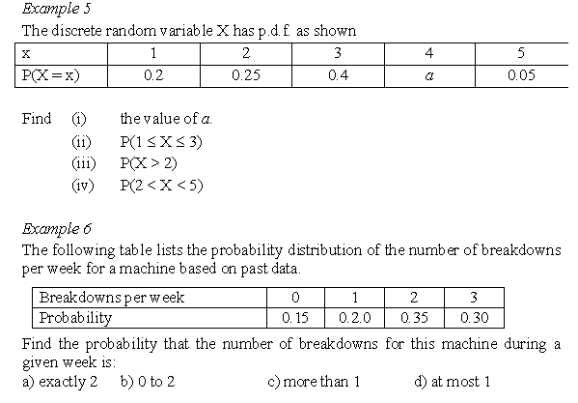

e) Hence find the mean and the standard deviation value.

Slide 19
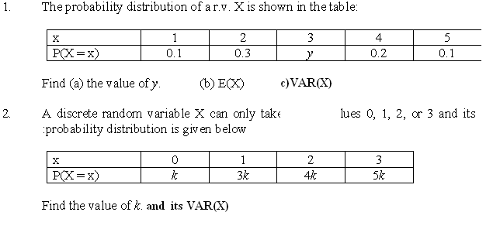
EXERCISE

Slide 20
STAT131
CHI SQUARE DISTRIBUTION-
GOODNESS OF FIT TEST

Slide 21
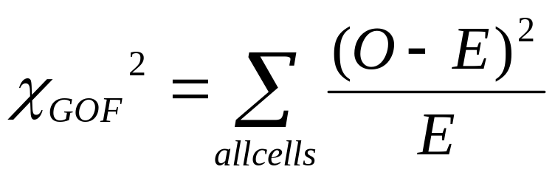
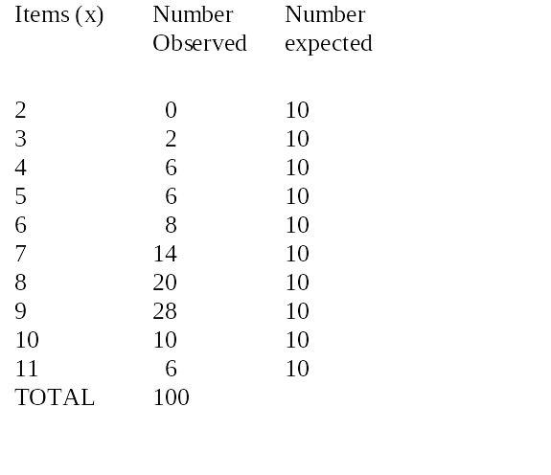
Model Fit Using Chi Square Distribution
(O-E)

Slide 22
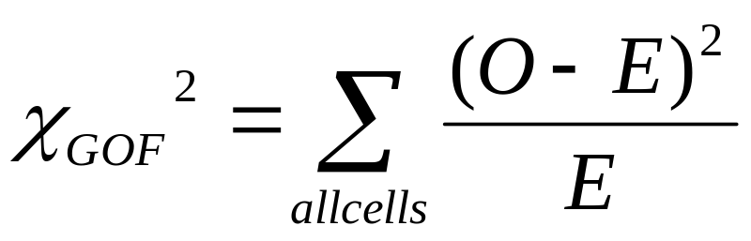
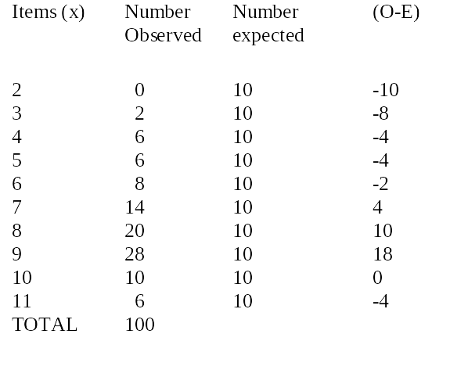
Calculating

Slide 23
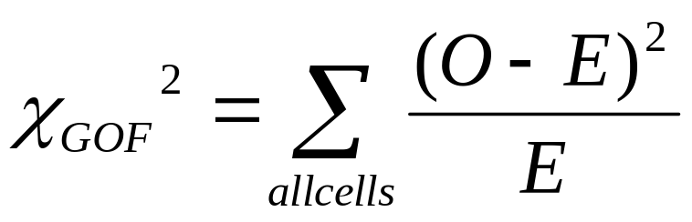
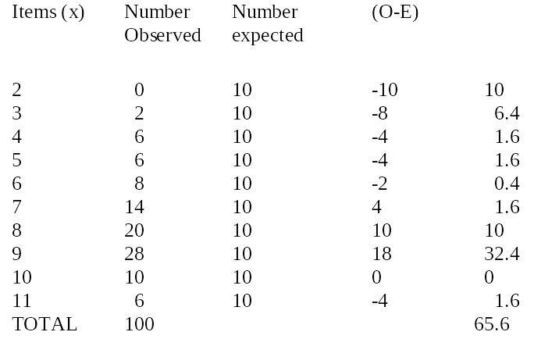
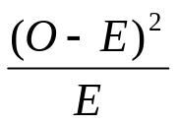
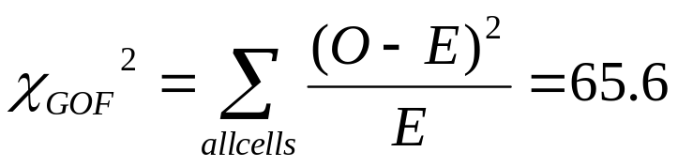
Calculating

Slide 24
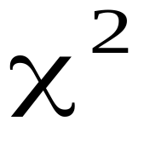
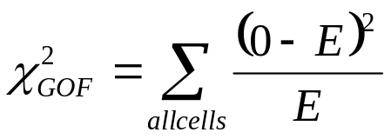
Model Fit Using
Calculate
And see if it is too large for the data to be considered to fit the model

Slide 25
Model Fit
Decision: If calculated > critical value of ( ( tables) then there is evidence of lack of fit
  α=0.05 (typical and we will use)
  df=Number of cells (n)-1
  df =10-1=9
Percentage Points of the distribution
df α
0.995 0.99 0.05 0.025 0.01 0.005
1 3.841 5.024 6.635 7.879
9 1.735 2.088 16.919 19.023 21.666 23.589

Slide 26
Model Fit Formal
Decision: As calculated =65.6 > critical value of 16.919 found in the tables there is evidence of lack of fit between the data and the model.
Percentage Points of the distribution
df α
0.995 0.99 0.05 0.025 0.01 0.005
1 3.841 5.024 6.635 7.879
9 1.735 2.088 16.919 19.023 21.666 23.589

Slide 27
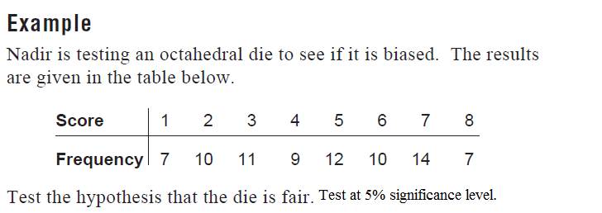

Slide 28
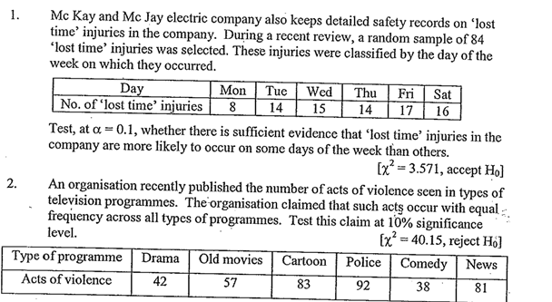
EXERCISE

